Slide 1



THINK UNLIMITED.
HOME
ABOUT
CONTENT
OTHERS
Group Number : 256
PRESENTS
SpeakSmart + CalmCore AI
Team Members
JAHNVI PANDEY (24BCE10794)
Raunak Kumar Modi (24BCE10279)
Rishi Singh Shandilya (24BCE11522)
Unnati Lohana (24BCE11335)
Vedant Singh (24BCE10073)
Real-Time Coach for Public Speaking and Interviews
Next Slide
"We solve the problem of public speaking anxiety by providing real-time, AI-powered feedback on voice and tone. ”
DR. MOHAMMAD ISHRAT
Name of the Supervisor :

Slide 2
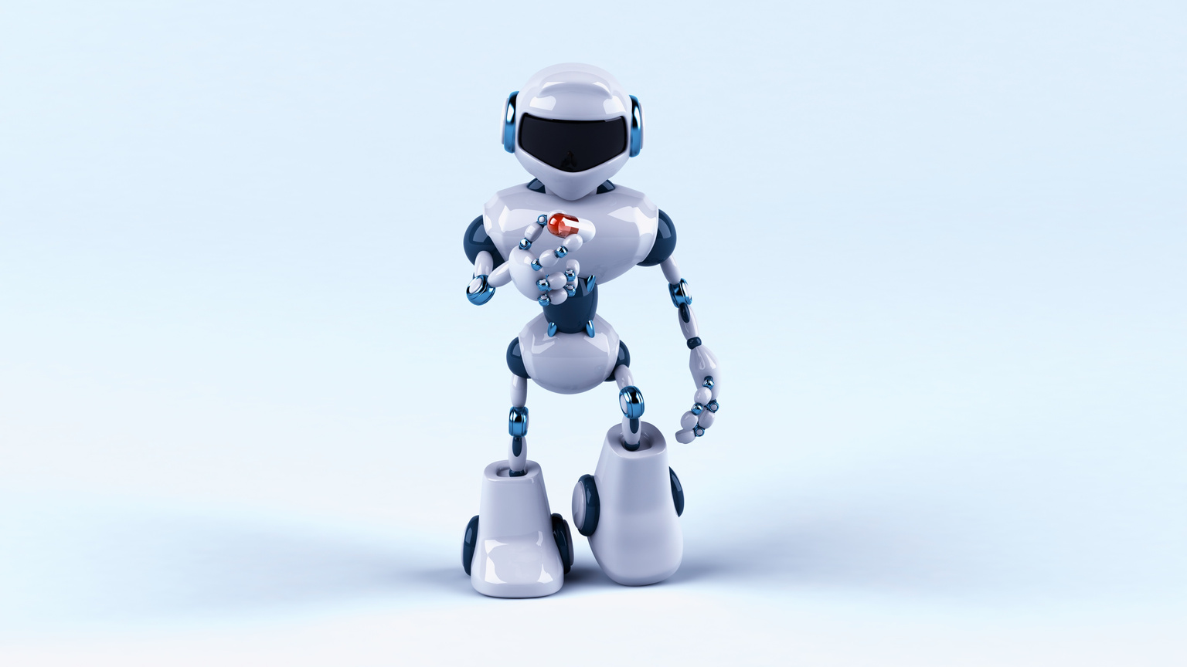
THINK UNLIMITED.
HOME
ABOUT
CONTENT
OTHERS
Problem Identification & Project Objectives
Most people fumble in interviews or presentations not because they lack knowledge but because they are unprepared on how to speak confidently. Traditional methods like speaking in front of a mirror lack real-time feedback, leaving a significant gap in effective communication skill development.
Real-time Nervousness Detection
AI-based Improvement Feedback
Track Personal Growth Over Time
ANALYZE VOICE PITCH AND TONE IN REAL-TIME TO DETECT MOMENTS OF ANXIETY.
PROVIDE PERSONALIZED, AI-DRIVEN SUGGESTIONS TO ENHANCE COMMUNICATION SKILLS.
RACK USER PROGRESS AND IMPROVEMENT OVER SESSIONS TO SHOW A CLEAR LEARNING CURVE.

Slide 3
THINK UNLIMITED.
HOME
ABOUT
CONTENT
OTHERS
Literature Review & Existing Gaps
We have analyzed existing solutions and research to understand the current landscape of communication coaching tools. Our review focused on identifying the strengths of these tools and, more importantly, their limitations in addressing real-time public speaking anxiety.
Existing Solutions
Identified Gaps
Key References
AI SPEECH COACHES, LANGUAGE APPS.
LACK OF REAL-TIME FEEDBACK ON NERVOUSNESS.
REVIEWED MODELS (RAVDESS DATASET) & RESEARCH ARTICLES.

Slide 4


THINK UNLIMITED.
HOME
ABOUT
CONTENT
OTHERS
Architecture Diagram
User Speaks (Audio & Video)
↓
Feature Extraction
↓
ML/AI Model
↓
Feedback Engine
↓
Personal Progress Tracker
Methodology & Work Plan.
Next Slide

Slide 5
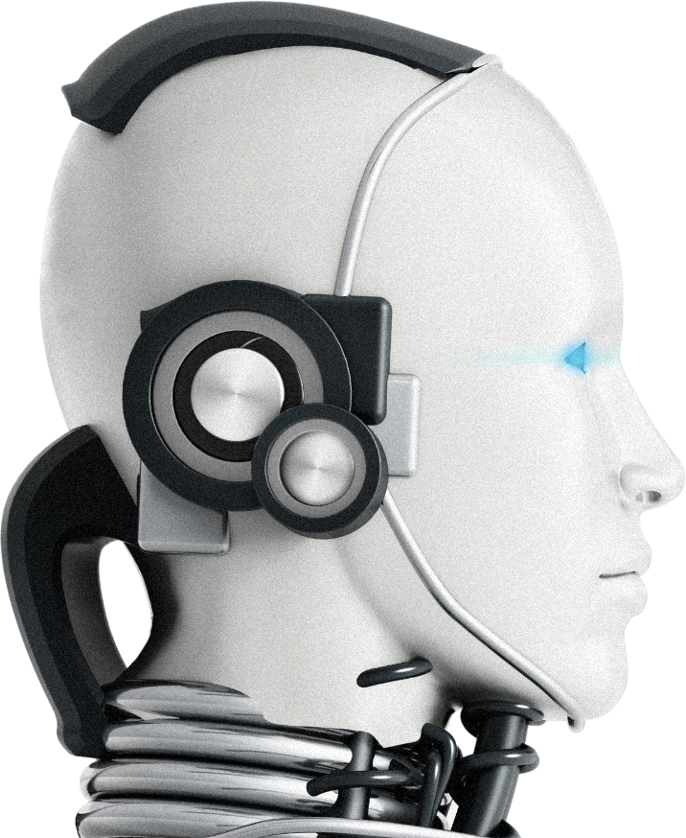
THINK UNLIMITED.
HOME
ABOUT
CONTENT
OTHERS
Technical Stack & Development Phases
TechnicalStack: Python(Flask/FastAPI),React.js, Librosa, OpenCV, TensorFlow, MediaPipe, SQLite.
Development Phases:
Phase 1: Research & Planning.
Phase 2: Model Training.
Phase 3: System Integration.
Phase 4: Testing & Deployment.
Next Slide

Slide 6
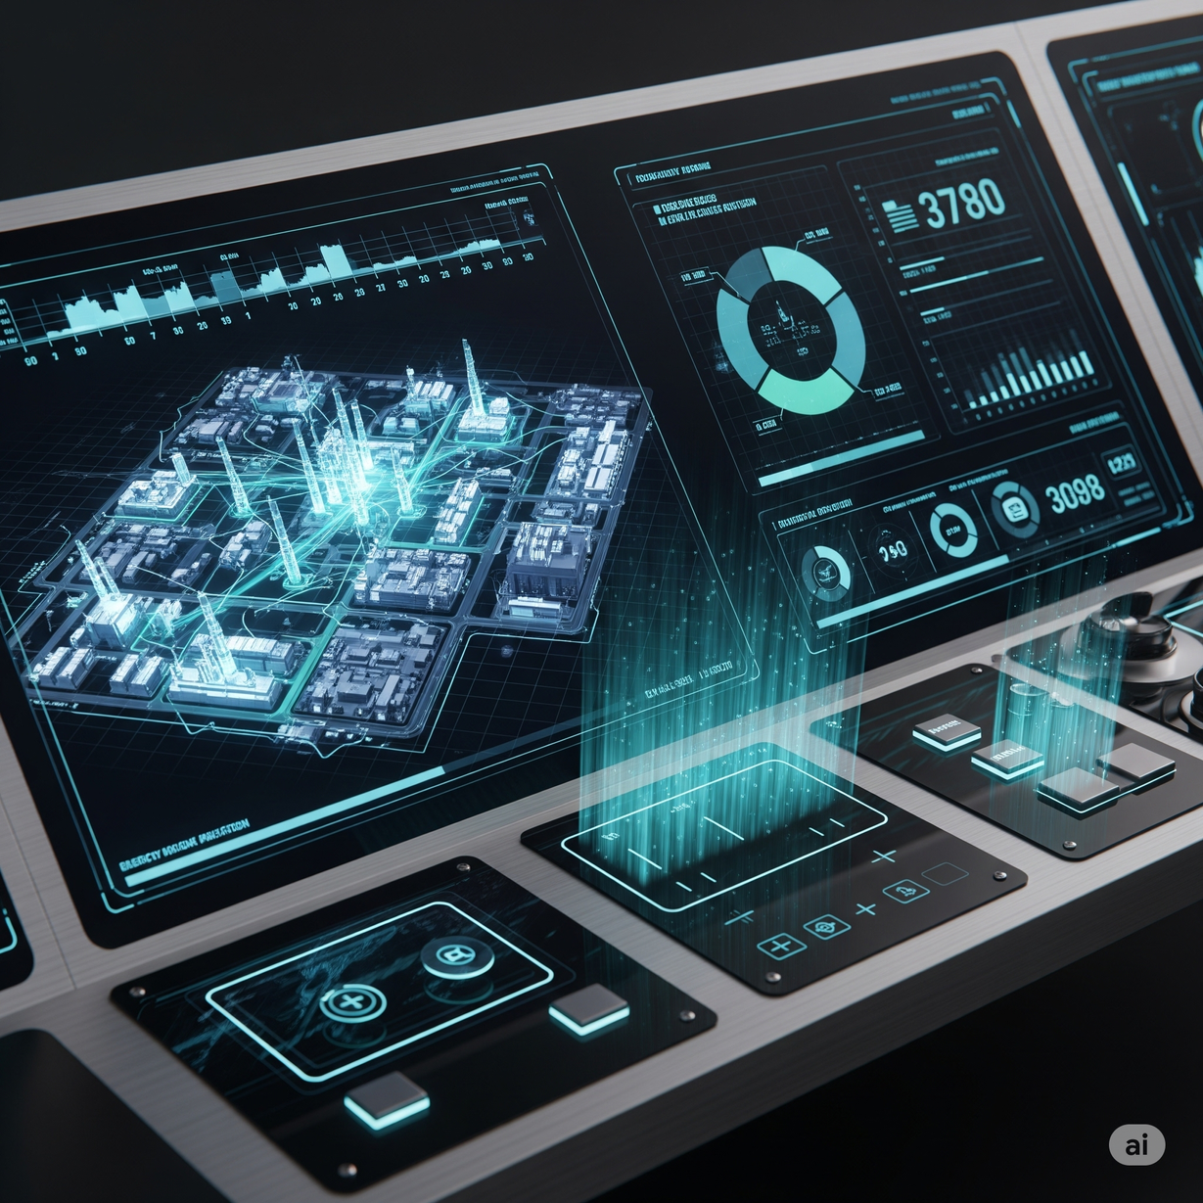
THINK UNLIMITED.
HOME
ABOUT
CONTENT
OTHERS
Resource Planning
OUR PROJECT IS DESIGNED TO BE HIGHLY RESOURCE-EFFICIENT, LEVERAGING EXISTING HARDWARE AND OPEN-SOURCE LIBRARIES TO MINIMIZE COST.
Hardware
Standard Laptop with mic and webcam
Software & Libraries
Content: Python, React.js, Flask/FastAPI, Librosa, OpenCV, SQLite.
Next Slide

Slide 7
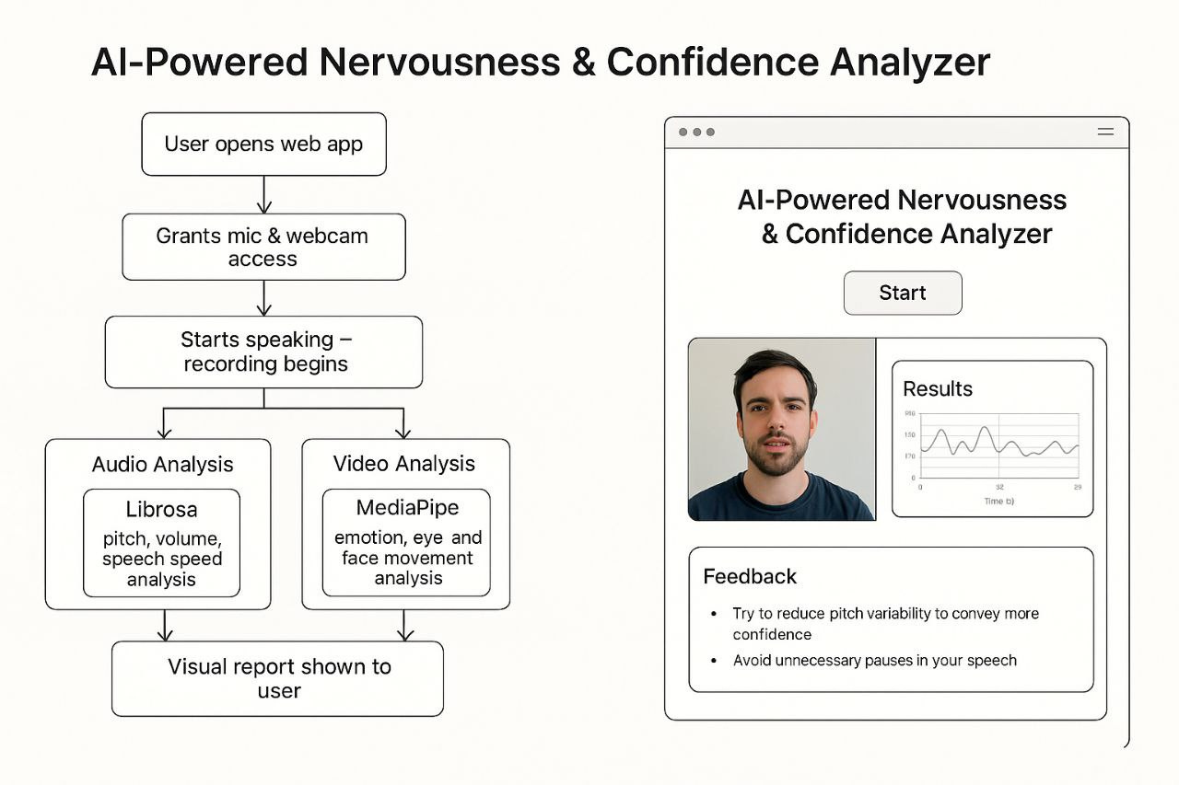
THINK UNLIMITED.
HOME
ABOUT
CONTENT
OTHERS
Project Demonstration
This is where you will showcase your tool in action. A live or pre-recorded demo is highly recommended to impress the evaluators. If you do not have a working demo, use UI mockups and sample output.
How a live recording session.
Display a real-time confidence score.
Present a sample feedback report.

Slide 8
THINK UNLIMITED.
HOME
ABOUT
CONTENT
OTHERS
Conclusion & Future Scope
Our project, SpeakSmart + CalmCore Al, not only builds technical skills but also addresses a real mental barrier faced by students and professionals. We believe this solution will empower users to communicate with confidence and clarity
THANK YOU

